Slide 1

Git & GitHub
Mike Maycock, GRETB
michael.maycock@gretb.ie

Slide 2

Introduction
Mike Maycock
Overview of Git & GitHub
“Git” is the commands we use
“GitHub” is the website where we
store stuff
Git can be used with Visual Studio
and Visual Studio Code

Slide 3
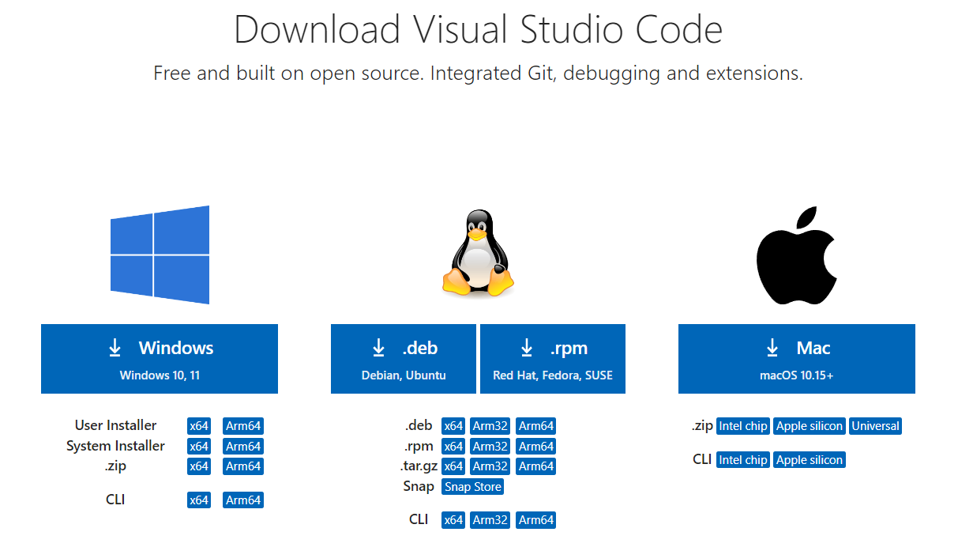
Git & GitHub
Step 1 – Download Visual Studio Code

Slide 4
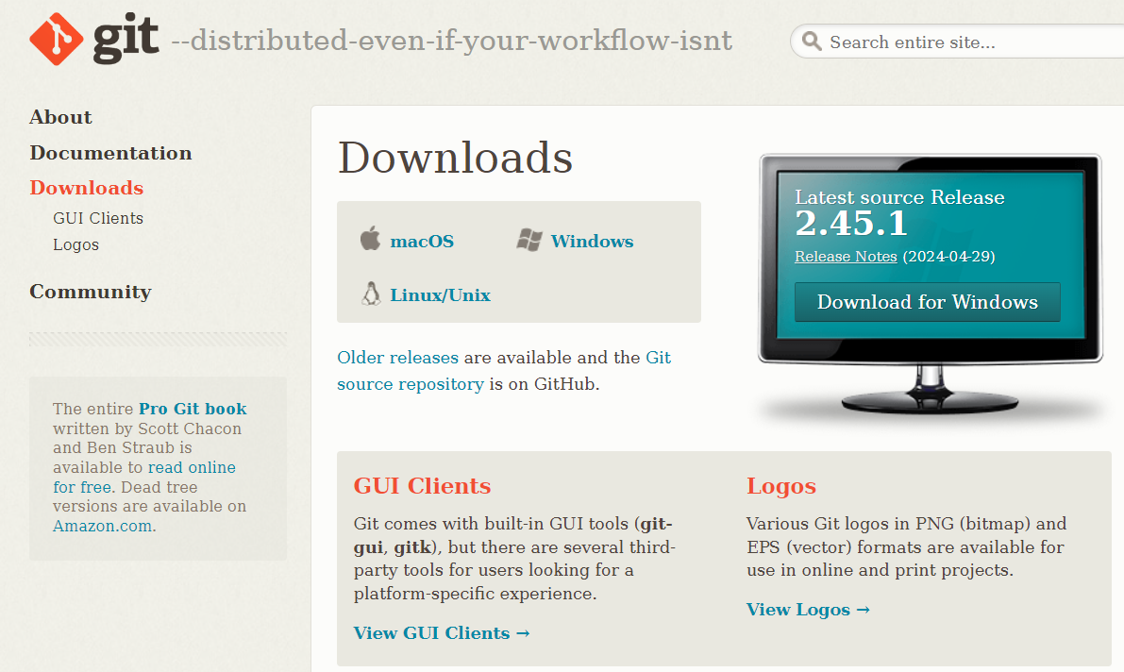
Git & GitHub
Step 2 – Download git

Slide 5

Git & GitHub
Step 3 – Create a GitHub Account

Slide 6

Git & GitHub
Step 4 – Download GitHub Desktop

Slide 7
Git & GitHub
How GitHub Works…
Create (or access) an online GitHub repository
Copy the URL of the repository
Paste the link into GitHub Desktop
GitHub Desktop opens the repository in VS Code

Slide 8
Git & GitHub
Quick 1 minute demonstration video…

Slide 9
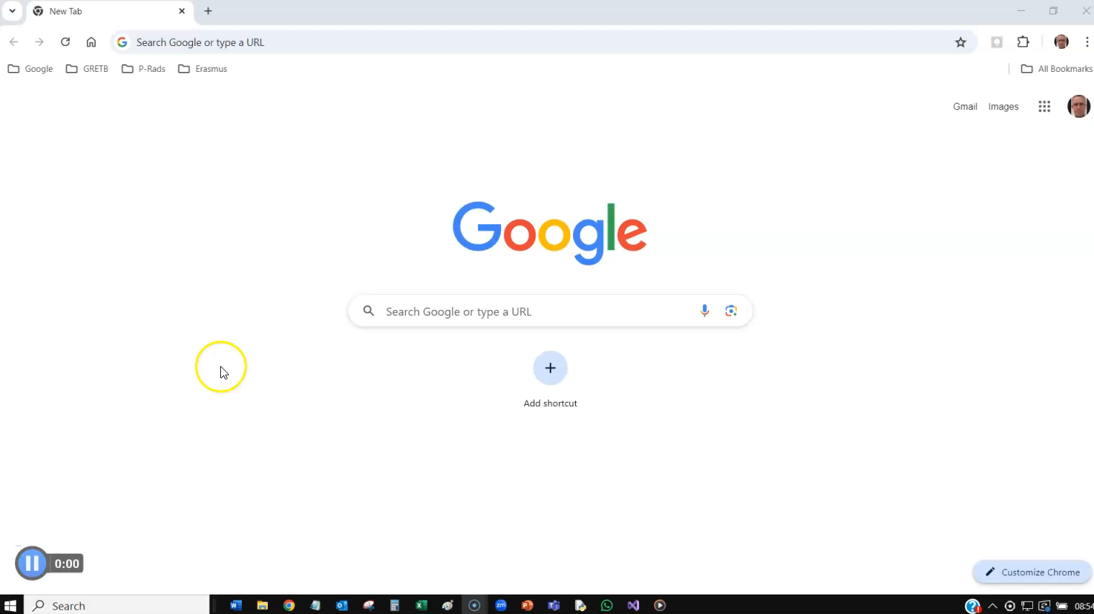
Git & GitHub

Slide 10
How to use Git in VS Code…
When finished programming;
Open a new terminal
Type git commands into the terminal;
git add – Add modified program to staging area
git commit - Commit changes in staging area
git push – Push program back to GitHub website

Slide 11
Git & GitHub
Quick 1 minute demonstration video…

Slide 12
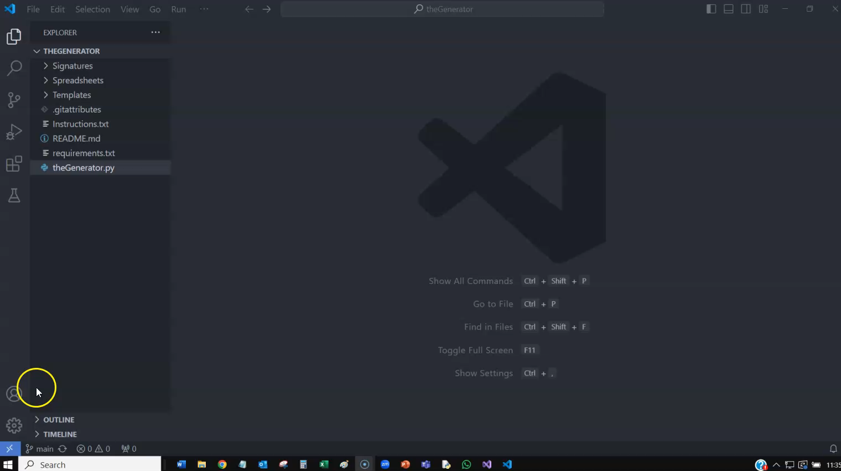
Git & GitHub

Slide 13
Git & GitHub
Branches & Branching
Un-technically, a branch is basically a copy of an existing repository
With branches, we can;
Create a new local branch of a repository
Work on programs in the local branch
Merge the changes in the local branch back into the main branch (on GitHub)

Slide 14
Git & GitHub
Branches & Branching
Branches allow us to;
Work collaboratively
Create different versions of an application

Slide 15
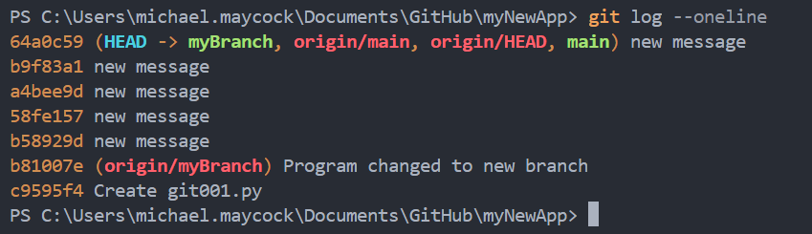
Git & GitHub
Branches & Branching

Slide 16
Git & GitHub
Commits
A “commit” is like a photo album
It stores a copy of all programs that were “committed”
We can view and/or roll back to previous commits if needs be

Slide 17
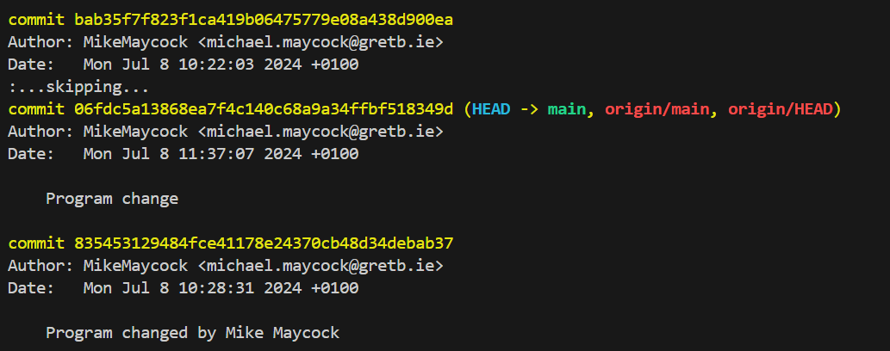
Git & GitHub
Commits

Slide 18
Git & GitHub
Other Git Commands
git diff allows us to see the differences between two versions of a program
git log allows us see the history of the commits of a branch
git checkout allows us to view a previously committed version of a program
git switch allows us to switch between branches
git restore allows us to undo changes

Slide 19
Videos…
I have shared a series of videos.
Feel free to ask Jane for access.

Slide 20

The End
michael.maycock@gretb.ie

